Slide 1

Scholarly Net
Group Carlson-Johnson
Xinyi Ding (s2507921)
Yongkang Qiu (s2605607)
Kejia Zhang (s2606445)
Yucheng Liang (s2476735)
*Logo generated by ChatGPT
Notes:
Hello, everyone, we’re group Carlson-Johnson. Today, we're excited to present our product "Scholarly Net," A website enhances scholarly exploration with easy access to networks among topics, authors and articles.

Slide 2
Contents
Product Key Features
Normalized Data Model
System Architecture & Technology Stack
Project Current Status
Prototype Demonstration
Further Development
2
Notes:
This presentation will cover website key features, data model, technology analysis. By the end, we will show you our current progress, the prototype demo, and future plans.

Slide 3
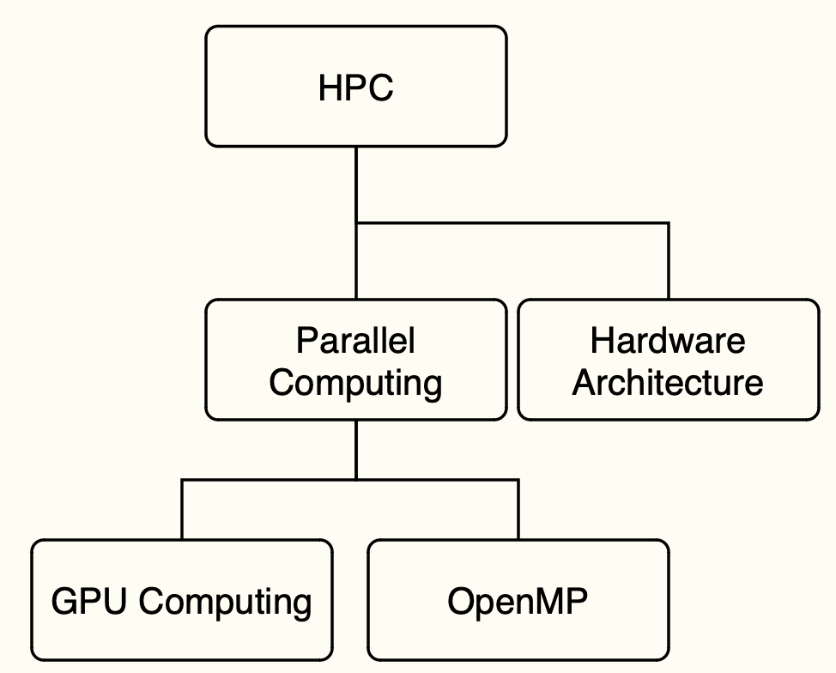
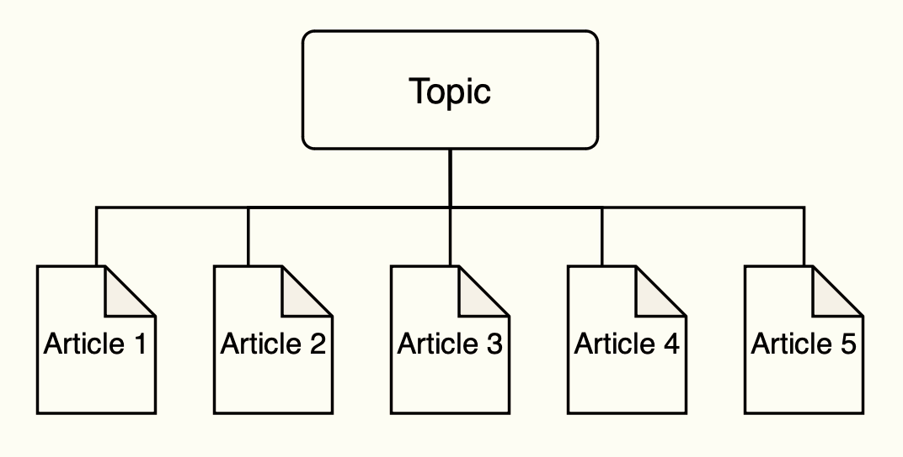
Product Key Features
Topic Relationships
Articles with the same topic
Topics in the same domain (Parent and child topics)
Figure.1 Articles with the same topic.
Figure.2 Example topic hierarchy
Created with www.draw.io
Notes:
Our website designed several key features based on clients requirements. Firstly, Users can navigate articles by topic relationships, viewing all articles under the same topic and exploring hierarchical relationships between topics.

Slide 4
Product Key Features
Author Relationship
Co-author (Authors work on the same article)
Colleague (Authors work in the same company or department )
Article Relationships (Citation/Reference)
For a selected article, a citation and reference network will presented.
User Defined Filter and Search
User can define filters for parameters such as author names, topics, keywords
User can search using specific terms or phrases related to their research interests.
Notes:
The system also allows users to find articles by author relationship, highlighting collaborative networks and linking co-authors and colleagues from the same institution. Additionally, the Article Relationships feature enables exploration of citation networks, displaying references and citing articles. User-defined filters and search capabilities enhance research experiences, allowing efficient discovery of relevant content. These functions will be demonstrated during the prototype demonstration later.

Slide 5
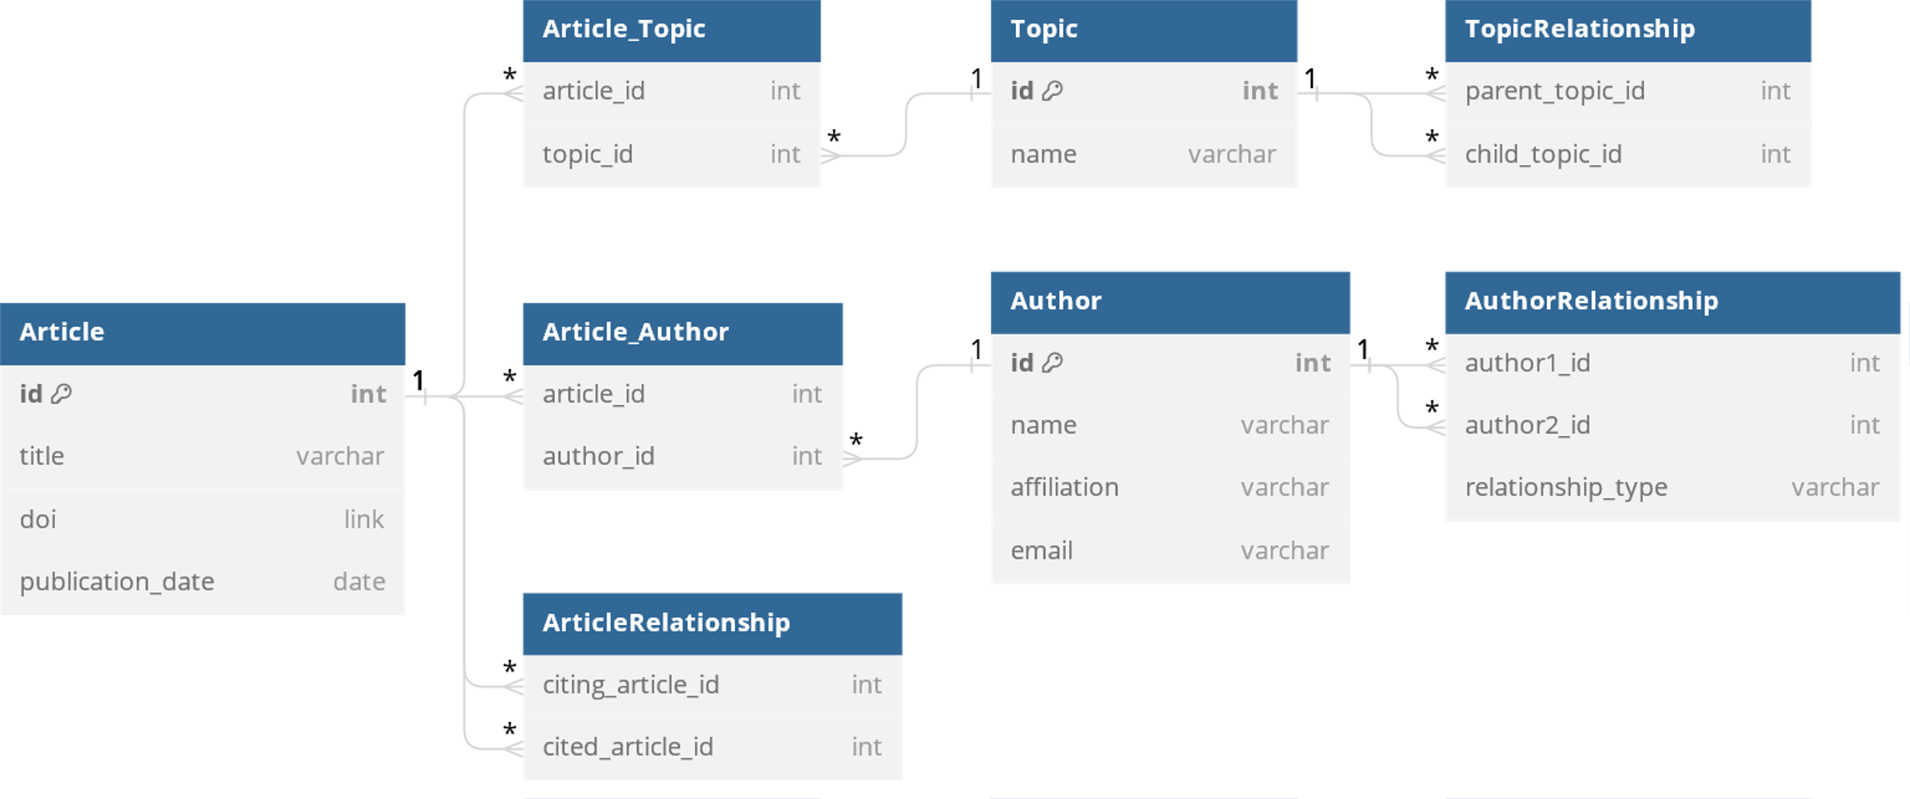
Normalized Data Model
Use normalized data model to minimize data redundancy in the database.
Figure.3 Entity-Relationship Diagram
Created with dbdiagram.io
Notes:
Based on these requirements, we designed a data model to store the data and their relationships. Here we choose the normalized data model to minimize data redundancy in the database. Let’s take a closer look at this entity-relationship diagram. We have three main data tables, article, topic and author. We connect articles to topics and authors via the Article_Topic and Article_Author tables, allowing for a many-to-many relationship between articles, topics, and authors. Additionally, three more tables are designed for storing the relationship between authors, the hierarchical relationship between topics, and the citation relationship between articles, ensuring an organized and efficient data structure.

Slide 6
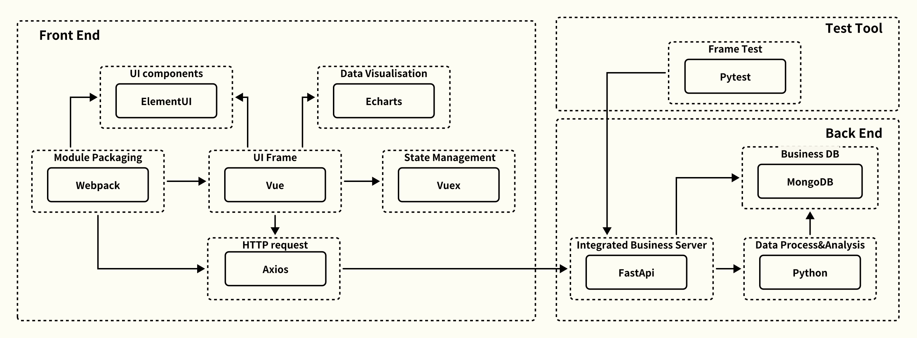
System Architecture
Figure.4 Font-to-Back End Architecture
Created with Lark Docs

Slide 7
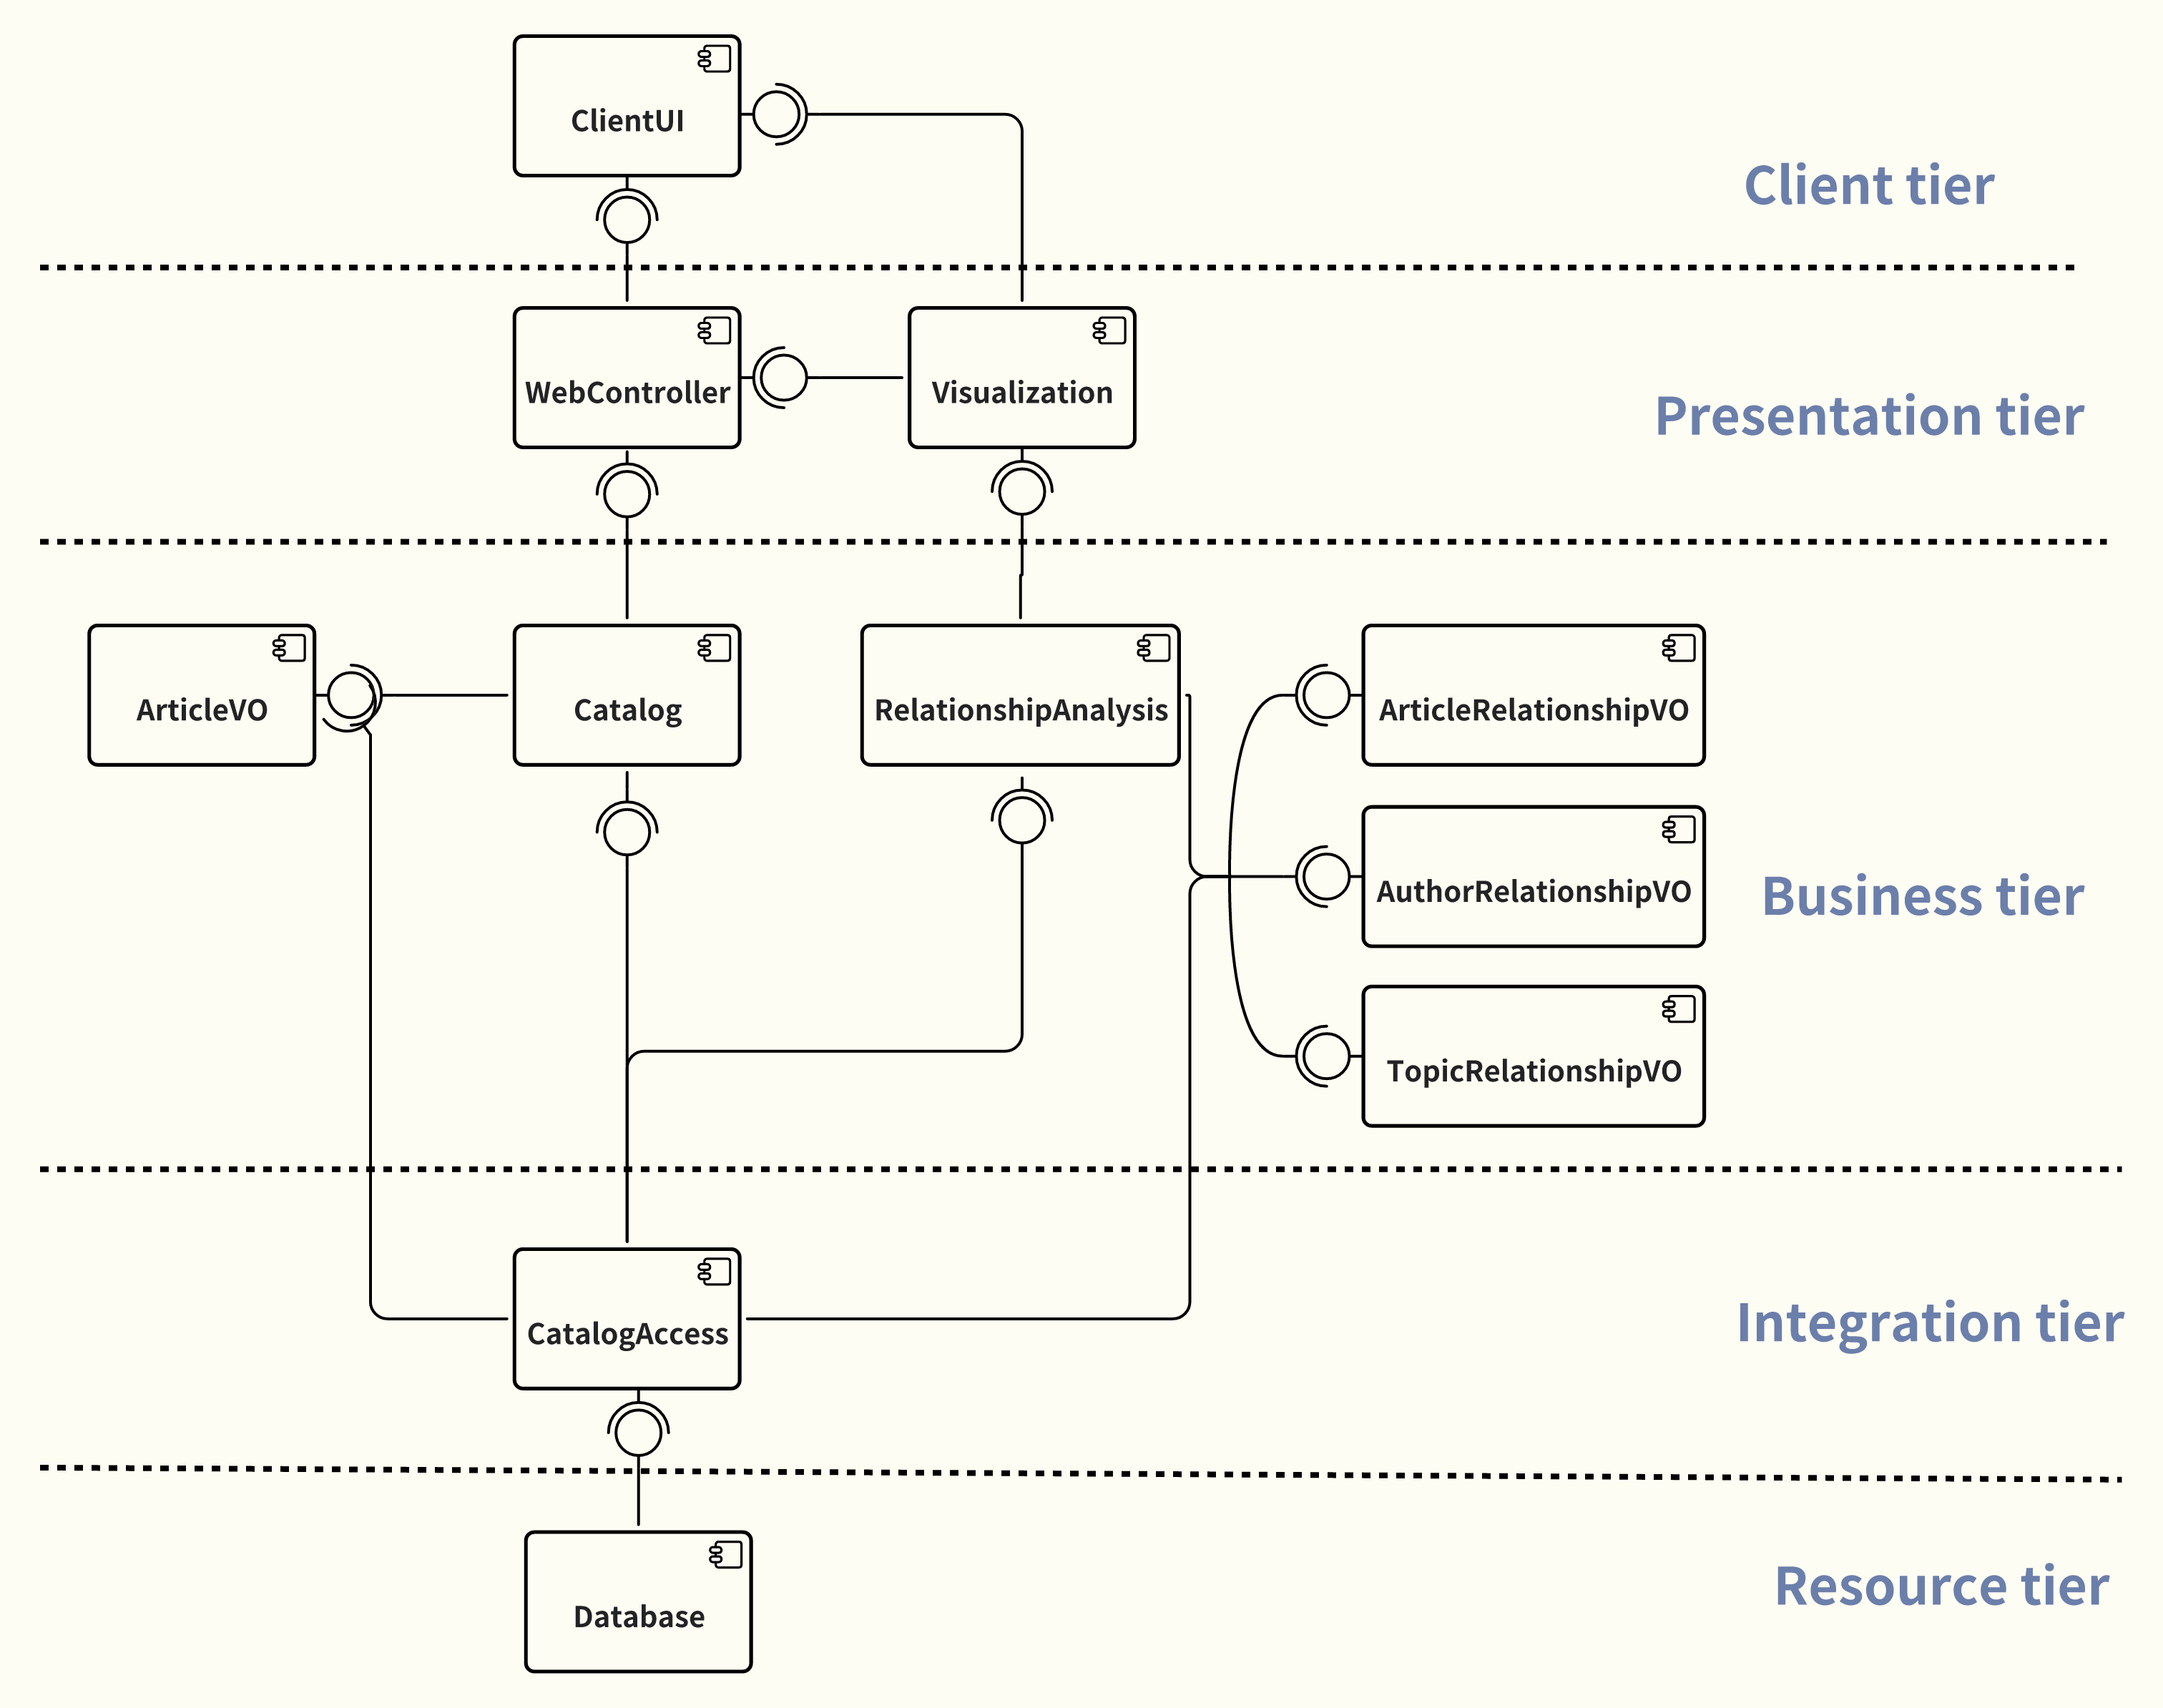
Technology Stack
Figure.5 5-Tier Architecture
Created with Lark Docs

Slide 8
Project Current Status
85%
40%
10%
30%
Complete
Complete
Complete
Complete
Design
Develop
Test
Deploy
Requirement Analysis
Function Design
Database Design
UI Design
Build Database
Back-end Dev
Unit Test
UI Test
Beta Release
Final Release
MVP Release
Front-end Dev
Integration Dev
Integration Test
8

Slide 9
Achievements & Milestones
Summative Milestone 1 Due: 17th Nov, 2023
Review of Prototype
Collect Requirement
Requirement Analysis
Function Design
Project Plan
Test Plan
User Interface Design
Evaluate Prototype
Due: 18th Oct, 2023
Group Presentation
Due: 20th Feb, 2024
9

Slide 10
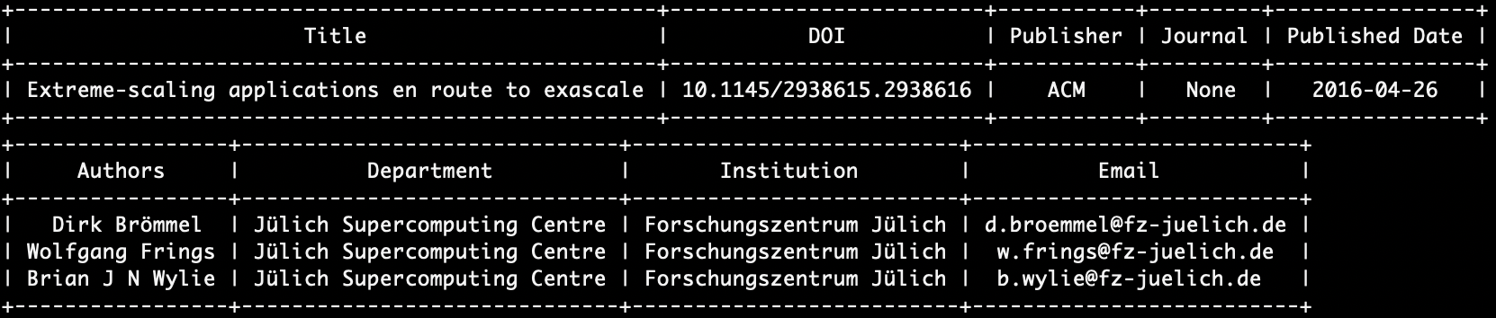
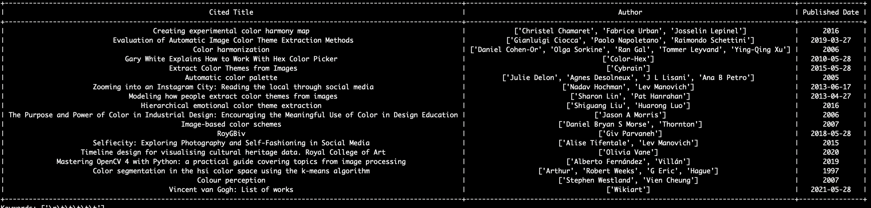
Current Back-end Status
Figure.6 Terminal Output Examples
10

Slide 11
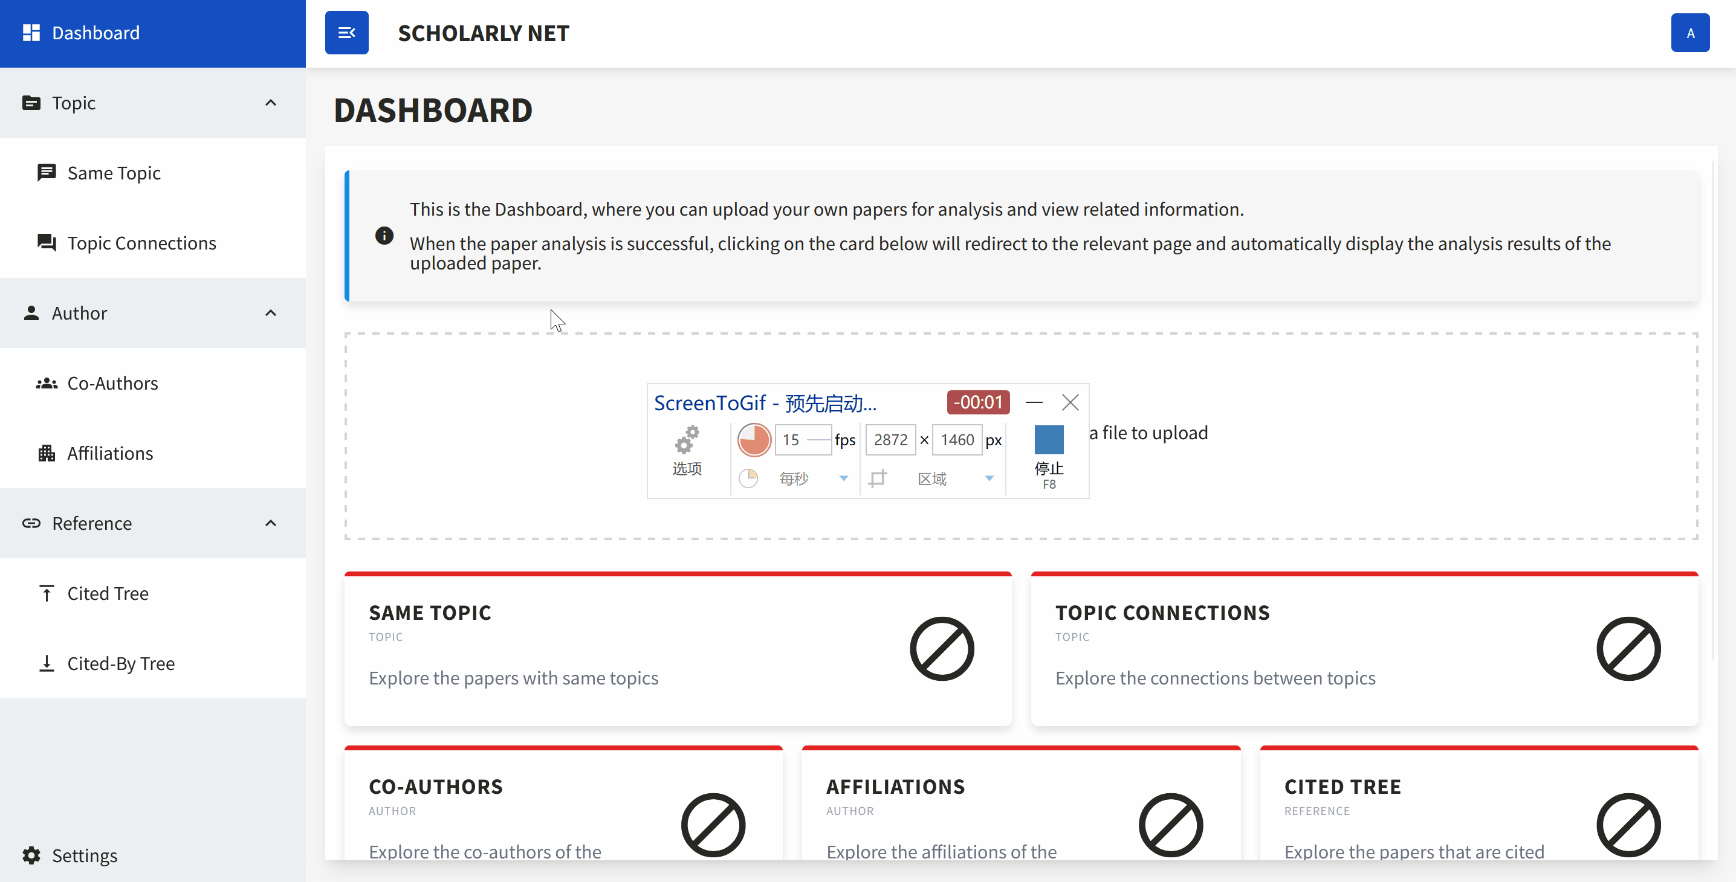
Demo - Dashboard
Upload and analysis of the uploaded PDF document
11

Slide 12
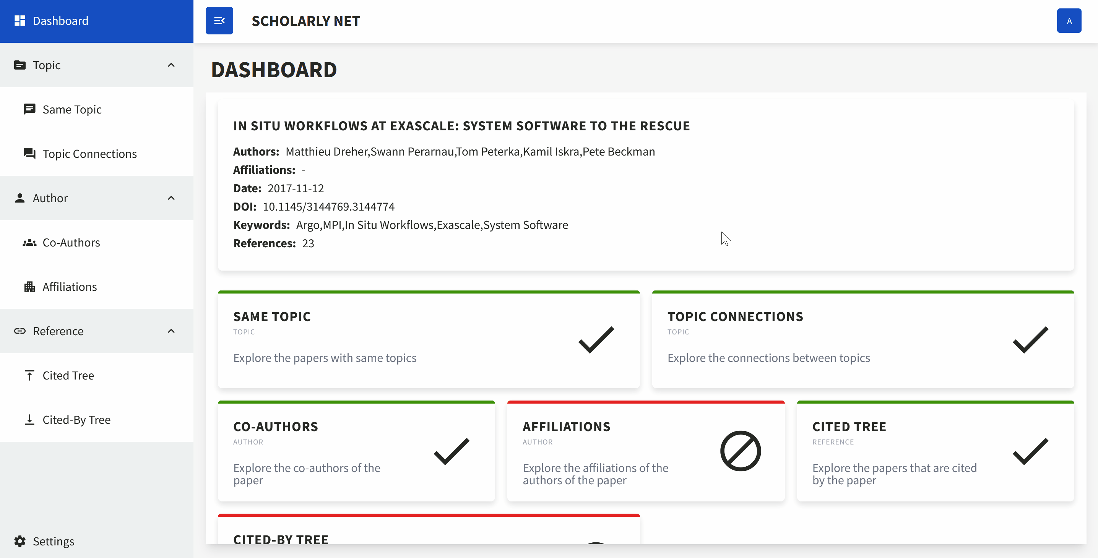
Demo - Same Topic
Show the relations between papers with the same topics
12

Slide 13
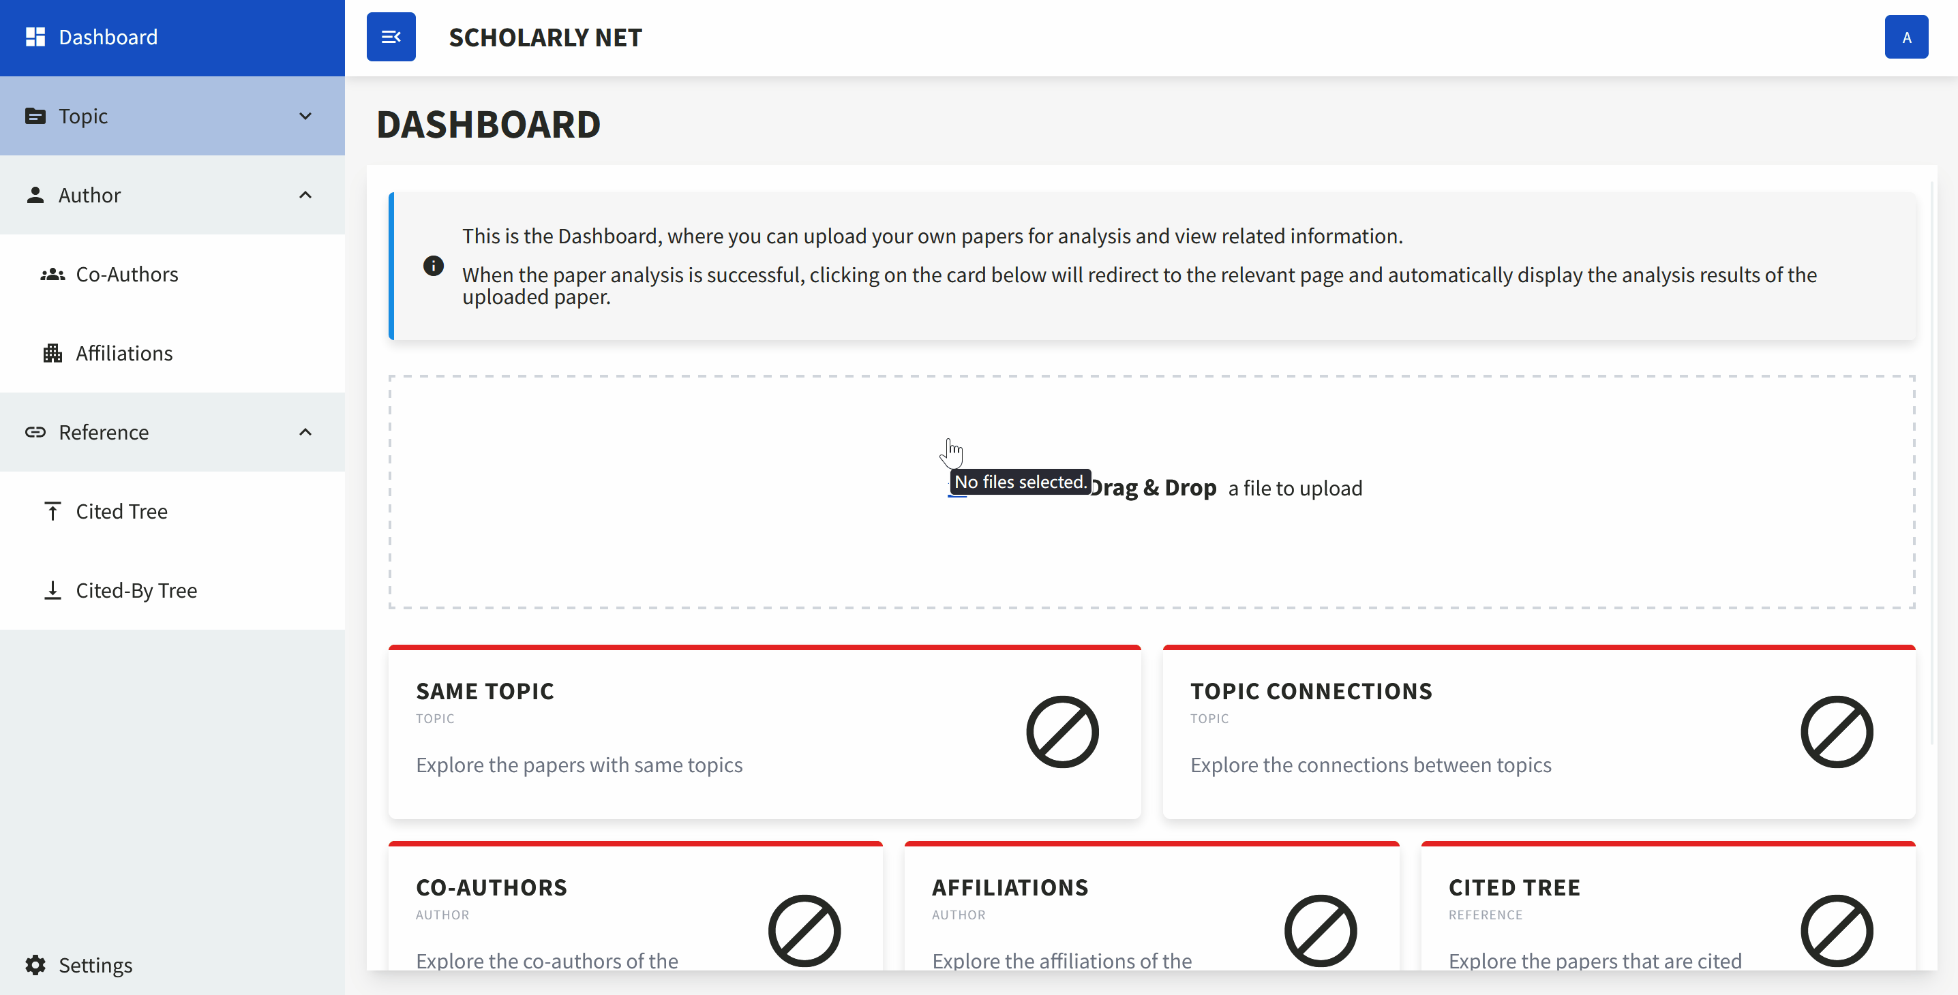
Demo - Search
User defined search for base paper (searched or uploaded)
13

Slide 14
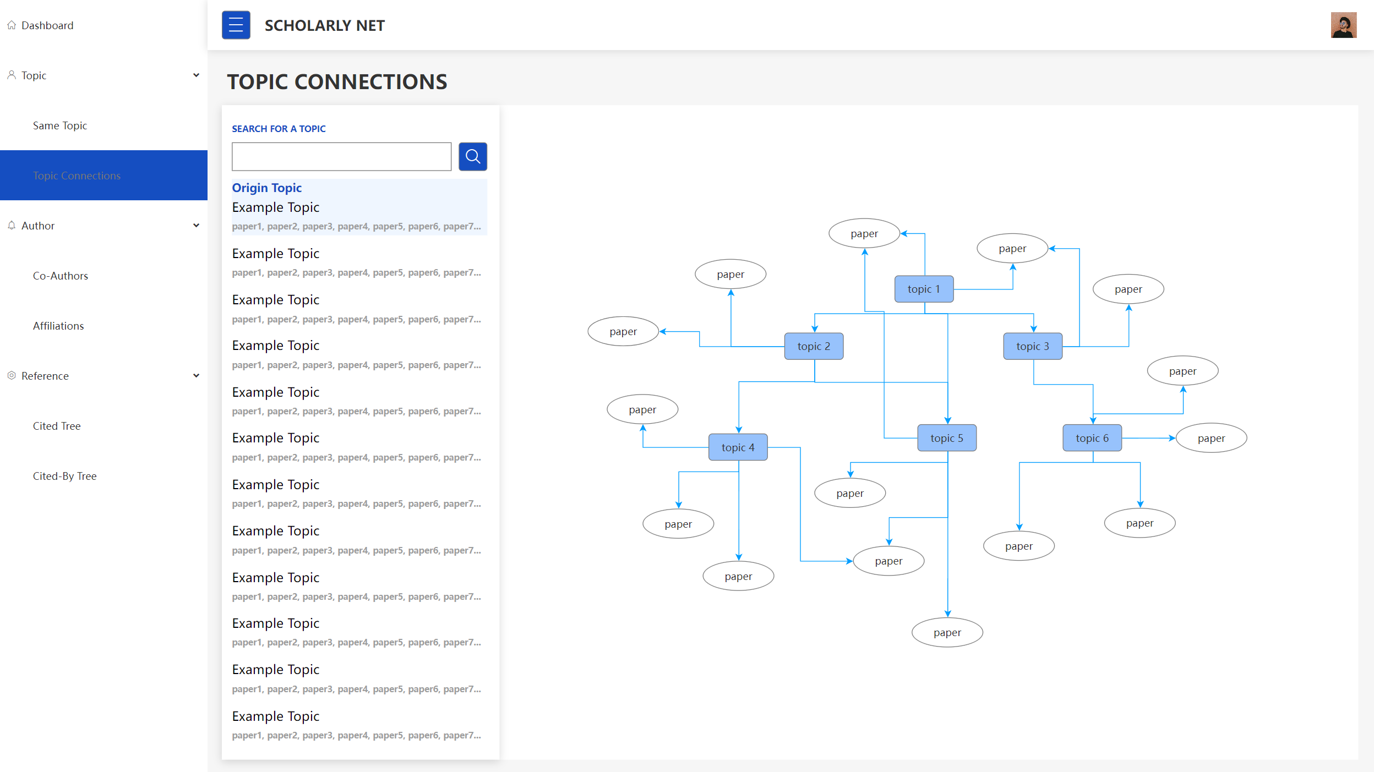
Prototype - Topic Connections
Show the relations between topics
14

Slide 15
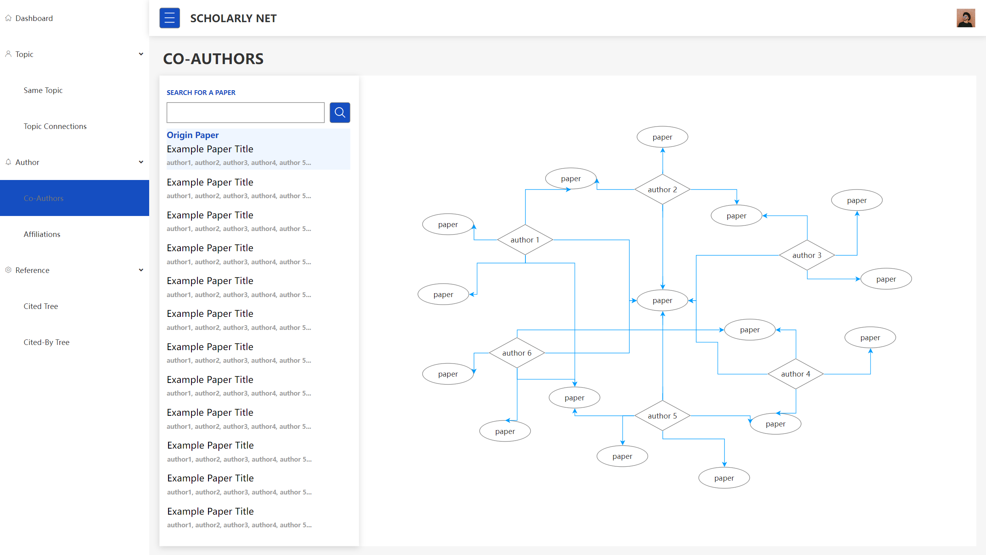
Prototype - Co-Authors
Show the relations between authors
15

Slide 16
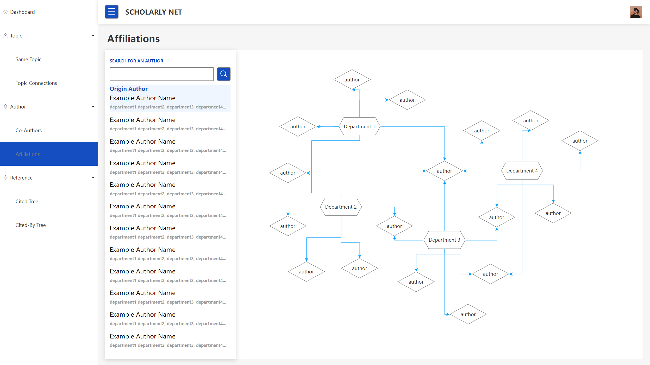
Prototype - Affiliations
Show the relations between authors and departments
16

Slide 17
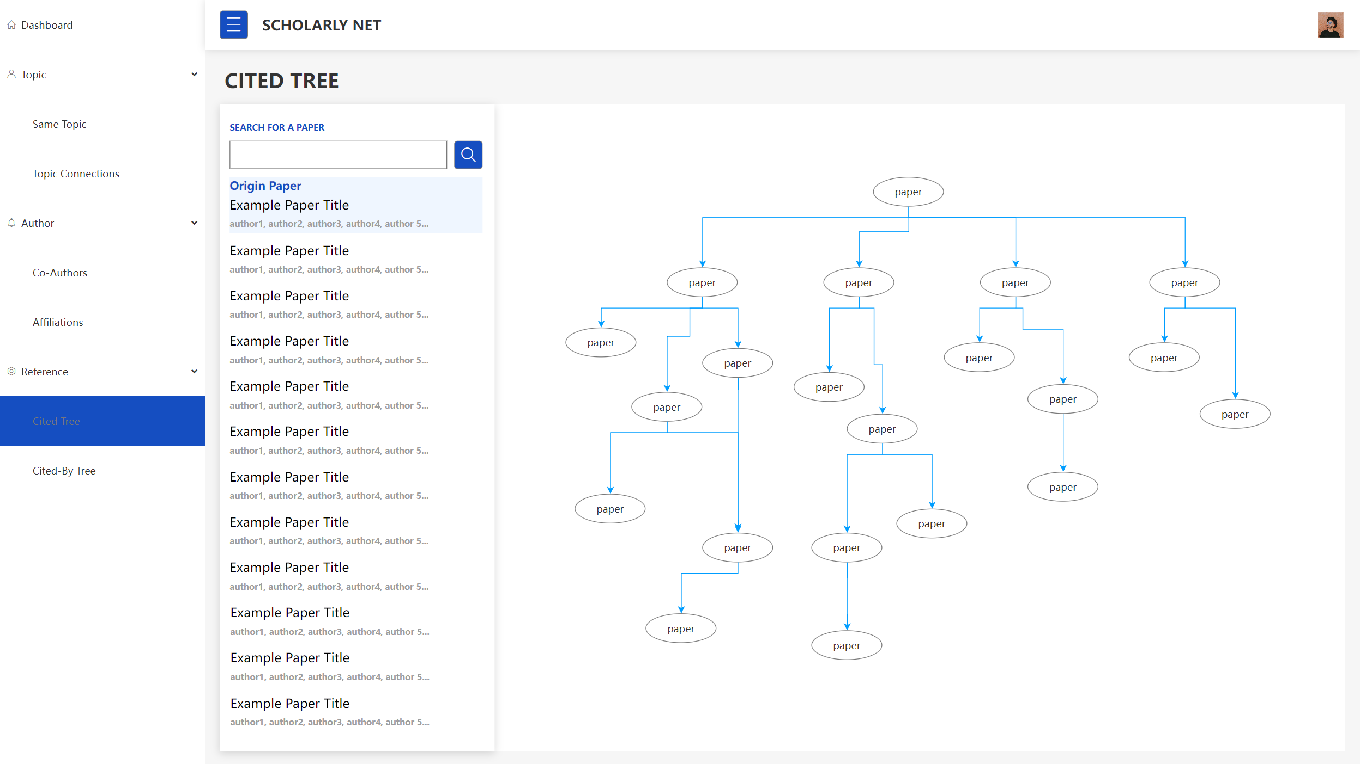
Prototype - Cited Tree
Show the cited reference relations between papers
17

Slide 18
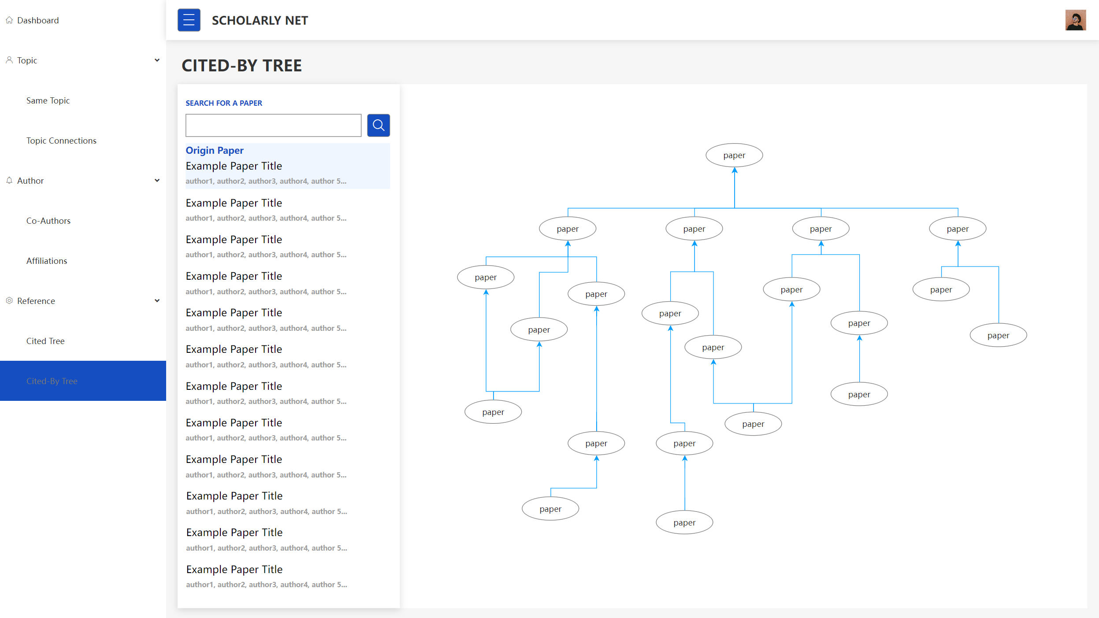
Prototype - Cited-By Tree
Show the cited-by reference relations between papers
18

Slide 19
Further Development
Database Integration
Frontend-Backend Integration
Testing
Collect feedback from users
Optimisation
Correctness for the data extraction
User Experience
Maintainability and scalability
Summative Assessment
Due: 20th Mar, 2024
Personal Assessment
Due: 15th May, 2024
19

Slide 20
Acknowledgement
A special thank you to the EPCC Practical Software Development course team for providing the foundational knowledge and skills essential for our project's development.
We extend our profound gratitude to Daniyal Arshad for his invaluable mentorship and guidance throughout our project.
We also wish to express our appreciation to our clients for their trust and support.
We thank all the participants for their interest and participation.
20

Slide 21

Reusing this material
This work is licensed under a Creative Commons Attribution-NonCommercial-ShareAlike 4.0 International License.
https://creativecommons.org/licenses/by-nc-sa/4.0/
This means you are free to copy and redistribute the material and adapt and build on the material under the following terms: You must give appropriate credit, provide a link to the license and indicate if changes were made. If you adapt or build on the material you must distribute your work under the same license as the original.
Acknowledge EPCC as follows: “© EPCC, The University of Edinburgh, www.epcc.ed.ac.uk”
Note that this presentation contains images owned by others. Please seek their permission before reusing these images.

